Slide 1

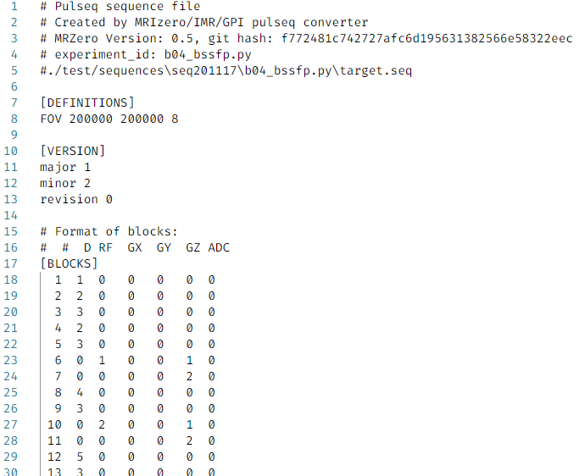

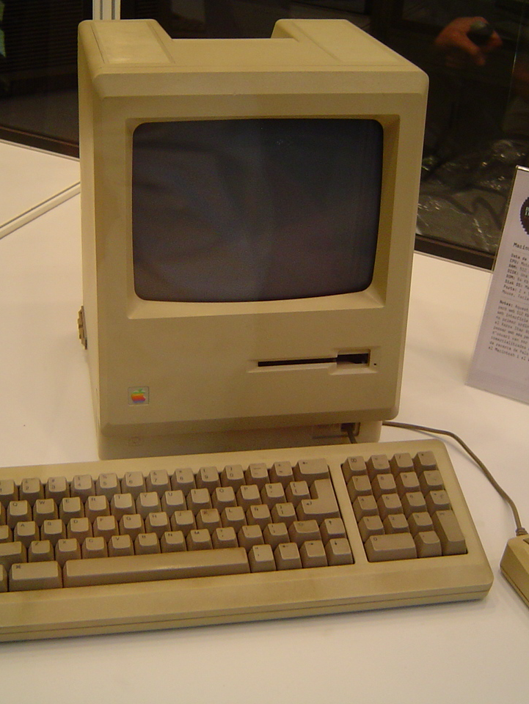
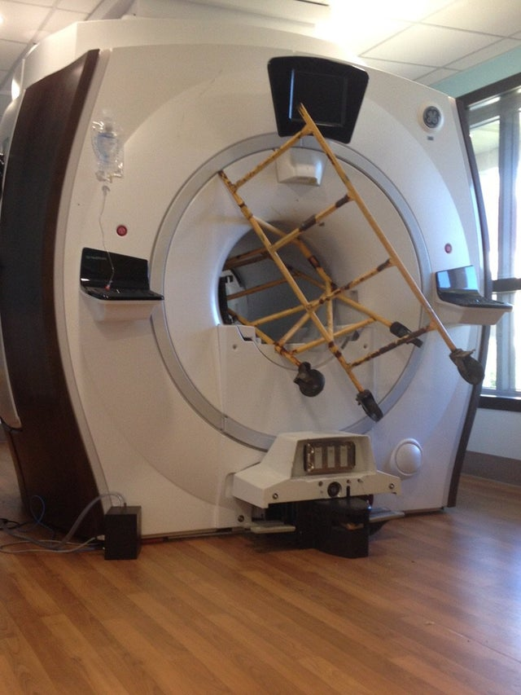
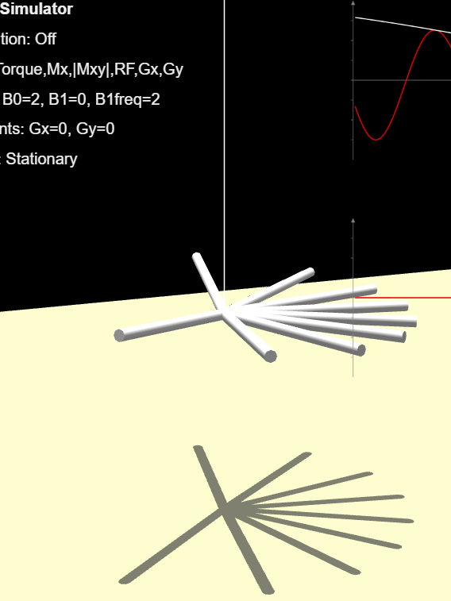
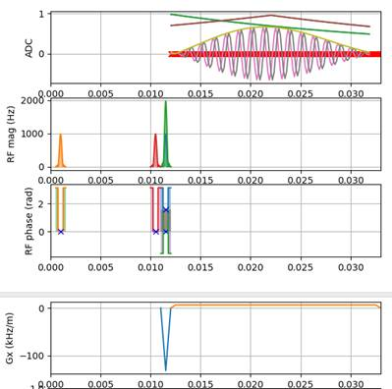
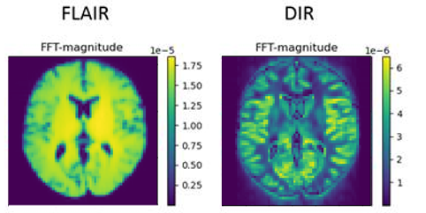
# Define a pulseq sequence
seq = Sequence()
...
seq.write('bSSFP.seq')
signal = sim_or_measure()
# Self-written reco
kspace = reorder(signal)
...
PDG Simulation
Measurement
Visualization
Signal
Reconstruction
https://mriquestions.com/projectiles.html
https://de.wikipedia.org/wiki/Datei:Old_computer_2.jpg

